Slide 1
Unit III
Fundamentals of Cloud Computing and Big Data
TCS 351
Ms. Sarishma
Assistant Professor,
Dept. of Computer Science and Engineering,
Graphic Era Deemed to be University

Slide 2
Syllabus
Infrastructure as a Service (IaaS): IaaS definition, Virtualization, Hypervisors, Machine Image, Virtual Machine(VM) Resource Virtualization Server Storage Network Virtual Machine (resource) provisioning and manageability, Data storage in cloud computing (storage as a service) Examples: Amazon EC2, EC2 Compute, Eucalyptus, Open Stack.
Platform as a Service (PaaS): PaaS definition, Service Oriented Architecture (SOA) Cloud Platform and Management Computation Storage, Examples: Google App Engine Microsoft Azure Salesforce.
Software as a Service (SaaS): SaaS definition, Web services, Web 2.0, Case Study on SaaS.

Slide 3
Infrastructure as a Service

Slide 4
Infrastructure as a service (IaaS) is a standardized, highly automated offering in which computing resources owned by a service provider, complemented by storage and networking capabilities, are offered to customers on demand. Resources are scalable and elastic in near real time and metered by use. Self-service interfaces, including an API and a graphical user interface (GUI), are exposed directly to customers. Resources may be single-tenant or multitenant, and are hosted by the service provider or on-premises in a customer’s data center.
-Gartner

Slide 5
The capability provided to the CSC to provision processing, storage, networks, and other fundamental computing resources where the CSC can deploy and run arbitrary software, which can include operating systems and applications.
The CSC does not manage or control the underlying cloud infrastructure but has control over operating systems, storage, and deployed applications, and possibly limited control of select networking components (e.g., host firewalls).
-NIST

Slide 6
IaaS is made up of a collection of physical and virtualized resources that provide consumers with the basic building blocks needed to run applications and workloads in the cloud.
Physical Data Centers
Compute
Network
Storage

Slide 7
Defining BMaaS
Bare-metal-as-a-Service (BMaaS) provides an even lower level of control than traditional IaaS. In a BMaaS environment, resources are still provisioned on-demand, made available over the internet, and billed on a pay-as-you-go basis (typically in monthly or hourly increments).

Slide 8
BMaaS vs IaaS
Unlike traditional IaaS, BMaaS does not provide end users with already virtualized compute, network, and storage; instead, it gives direct access to the underlying hardware. This level of access offers end users almost total control of their hardware specs.
High Performance
Costly
Secure
Disadvantage: The ability to really rapidly provision and horizontally scale resources by simply making copies of instances and load balancing across them – is not available for BMaaS.

Slide 9
Conclusion?
When it comes to BMaaS vs. IaaS, one model is not superior to the other—
it’s all about what model best supports the specific use case or workload.

Slide 10
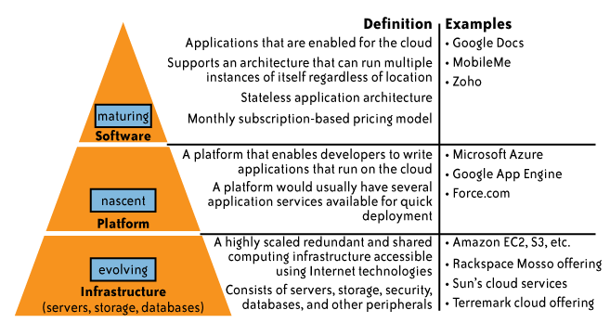
Taxonomy of Cloud Service Models

Slide 11

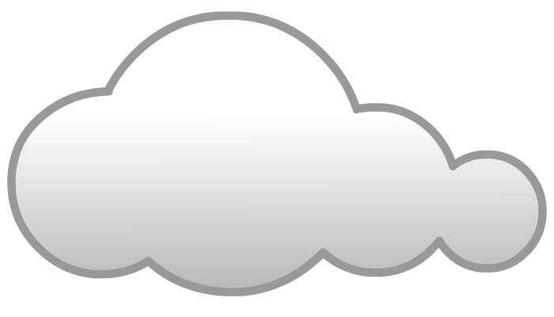
Infrastructure-as-a-Service
Provides capability to the consumer to hire infrastructure components such as servers, storage, and network
Enables consumers to deploy and run software, including OS and applications
Pays for infrastructure components usage, for example, Storage capacity, CPU usage, etc.
Application
Databases
OS
Compute
Storage
Network

Slide 12
IaaS Examples
Amazon Elastic Compute Cloud (EC2) is an IaaS model that provides resizable compute capacity on a pay-per-use basis
Allows consumers to hire virtual compute on which they run their own applications
EMC Atmos Online provides Storage as a service
Internet accessible, on demand storage
Common Examplë: DigitalOcean, Linode, Rackspace, Amazon Web Services (AWS), Cisco Metapod, Microsoft Azure, Google Compute Engine (GCE)

Slide 13
IaaS
IaaS provides capability to the consumer to hire infrastructure components such as servers, storage, and network.

Slide 14
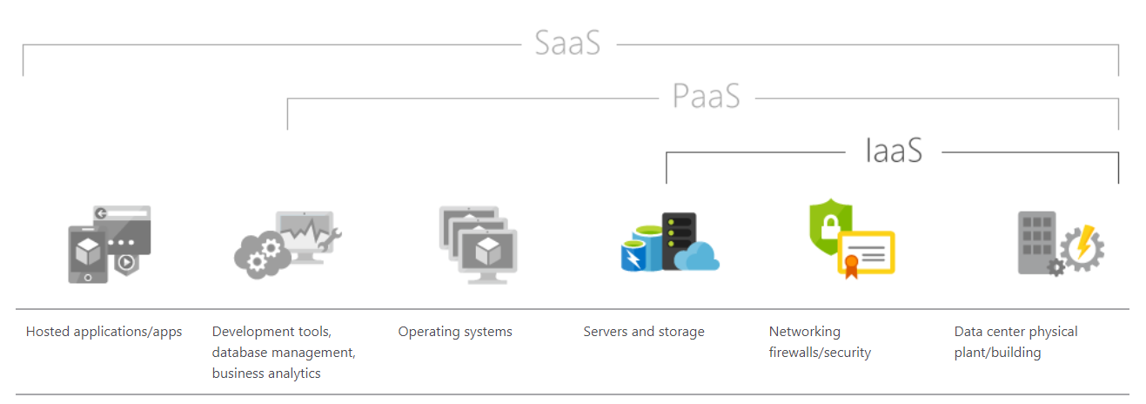

Slide 15
IaaS
Who are the consumers?
System administrators.
What does a consumer get?
Access to virtual computers, network-accessible storage, and network infrastructure components such as firewalls, and configuration services

Slide 16
IaaS represents general purpose compute resources and is thus capable of supporting use cases of all types.
Today, IaaS is most commonly used for
dev and test environments,
customer-facing websites and web applications,
data storage,
analytics and data warehousing workloads,
and backup and recovery, particularly for on-premises workloads.
for deploying and running common business software and applications

Slide 17
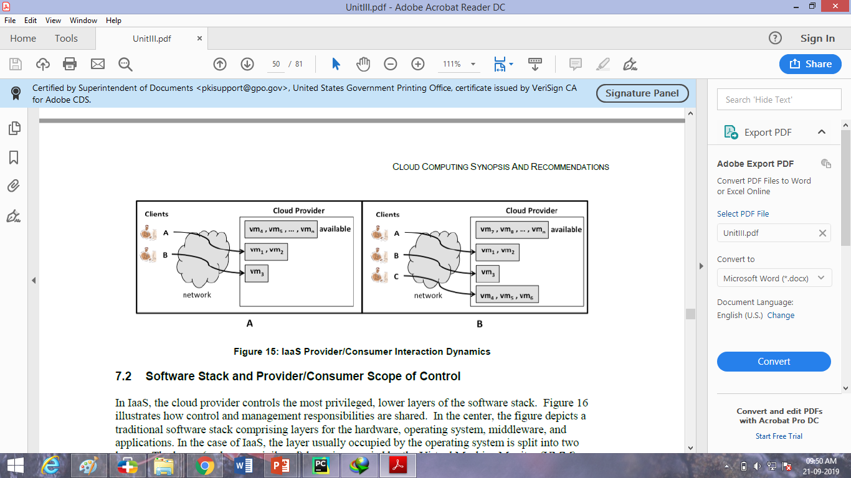
IaaS: Abstract Interaction Dynamics

Slide 18
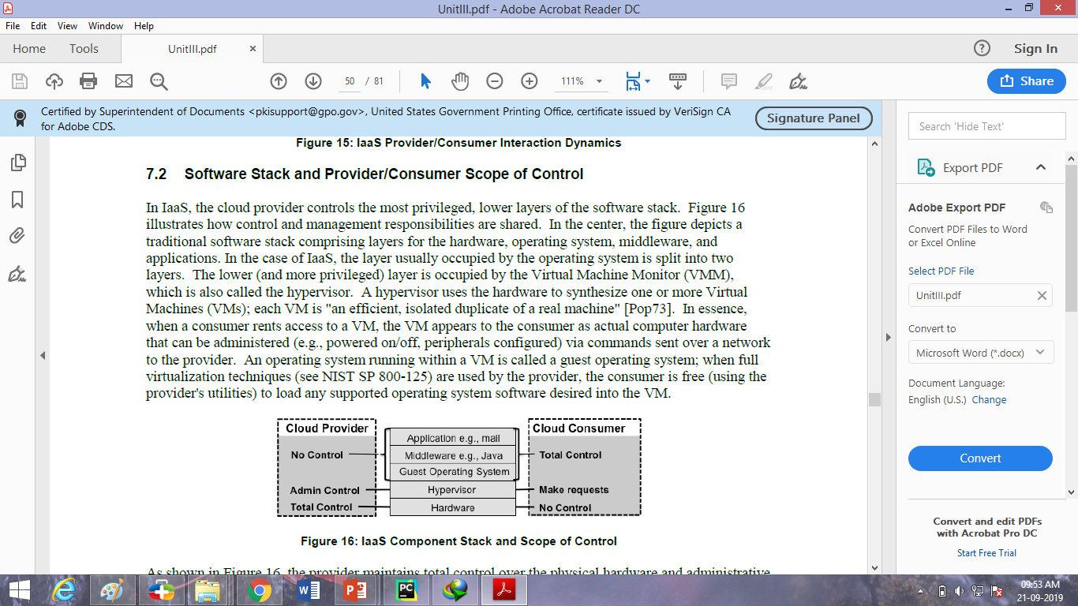
IaaS: Scope of Control

Slide 19
Advantages of IaaS
Cost Saving
IaaS model has lower infrastructure costs. No longer do organizations have the responsibility of ensuring uptime, maintaining hardware and networking equipment.
Eliminates capital expense and reduces ongoing cost. IaaS sidesteps the upfront expense of setting up and managing an onsite datacentre, making it an economical option for start-ups and businesses testing new ideas.

Slide 20
Scalability and flexibility:
One of the greatest benefits of IaaS is the ability to scale up and down quickly in response to an enterprise’s requirements.
IaaS providers generally have the latest, most powerful storage, servers and networking technology.
Increase stability, reliability and supportability.
With IaaS there is no need to maintain and upgrade software and hardware or troubleshoot equipment problems. With the appropriate agreement in place, the service provider assures that your infrastructure is reliable and meets SLAs.

Slide 21
Advantages of IaaS
High availability:
IaaS provides a consolidated disaster recovery infrastructure, reducing costs.
The result: quick recovery and high availability of services with no loss of data.
Improves business continuity and disaster recovery.
Achieving high availability, business continuity and disaster recovery is expensive, since it requires a significant amount of technology and staff. But with the right service level agreement (SLA) in place, IaaS can reduce this cost and access applications and data as usual during a disaster or outage.

Slide 22
Multitenant architecture, i.e. a single piece of hardware serves many users
Easy to use due to the automated deployment of hardware
Gets new apps to users faster. Because you don’t need to first set up the infrastructure before you can develop and deliver apps, you can get them to users faster with IaaS.

Slide 23
Advantages of IaaS
Focus on your core business. IaaS frees up your team to focus on your organization's core business rather than on IT infrastructure.
Increase stability, reliability and supportability.
With IaaS there is no need to maintain and upgrade software and hardware or troubleshoot equipment problems.

Slide 24
IaaS Advantages
Pay-as-you-Go: Unlike traditional IT, IaaS does not require any upfront, capital expenditures, and end users are only billed for what they use.
Speed: With IaaS, users can provision small or vast amounts of resources in a matter of minutes, testing new ideas quickly or scaling proven ones even quicker.
Availability: Through things like multizone regions, the availability and resiliency of cloud applications can exceed traditional approaches.

Slide 25
Scale: With seemingly limitless capacity and the ability to scale resources either automatically or with some supervision, it’s simple to go from one instance of an application or workload to many.
Latency and performance: Given the broad geographic footprint of most IaaS providers, it’s easy to put apps and services closers to your users, reducing latency and improving performance.

Slide 26
Disadvantages of IaaS
Security
The enterprise does not have any control over cloud security in an IaaS environment. They need to review the Cloud Service provider’s service level agreement (SLA) to help them understand its security obligations and thereby identifying gaps in their security coverage.
Lack of flexibility
Service providers maintain the software, but they do not upgrade the software for some of the businesses.

Slide 27
Disadvantages of IaaS
Technical problems
Organizations faces some downtime with IaaS, and it will restrict their access to applications and data.
Over Dependency
Having IaaS in your organization means have a full dependency on the provider or third party for your data
Upgrade & Maintenance
The organization is solely responsible for any upgrades of software and maintenance of tools or data system

Slide 28
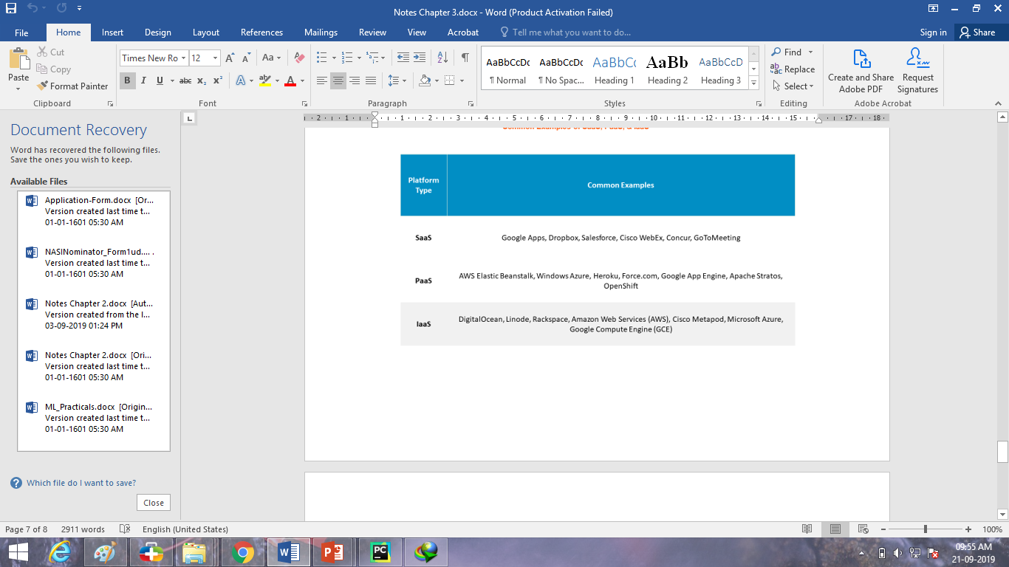

Slide 29
How are usage fees calculated?
Typically,
per CPU hour,
data GB stored per hour,
network bandwidth consumed,
network infrastructure used (e.g., IP addresses) per hour,
value-added services used (e.g., monitoring, automatic scaling).

Slide 30
Pricing
Subscriptions and reserved instances: Many providers offer discounts off the sticker price for clients willing to commit to longer contract terms, typically around one to three years.
Monthly billing: Monthly billing models are most common in the BMaaS market, where physical infrastructure typically implies steady state workloads without spiky characteristics.
By the hour/second: The most common granularity for traditional cloud infrastructure, end users are charged only for what they use.
Transient/spot: Some providers will offer up unused capacity at a discount via transient/spot instances, but those instances can be reclaimed if the capacity is needed.

Slide 31
IaaS vs Containers vs Microservices ?

Slide 32
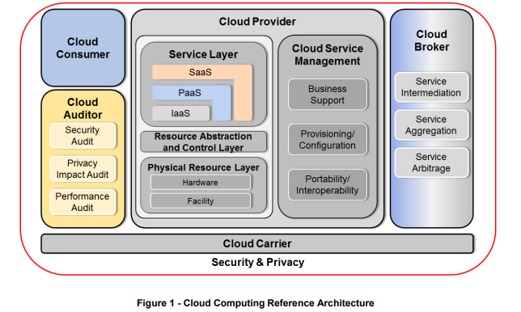

Slide 33
Virtualization

Slide 34
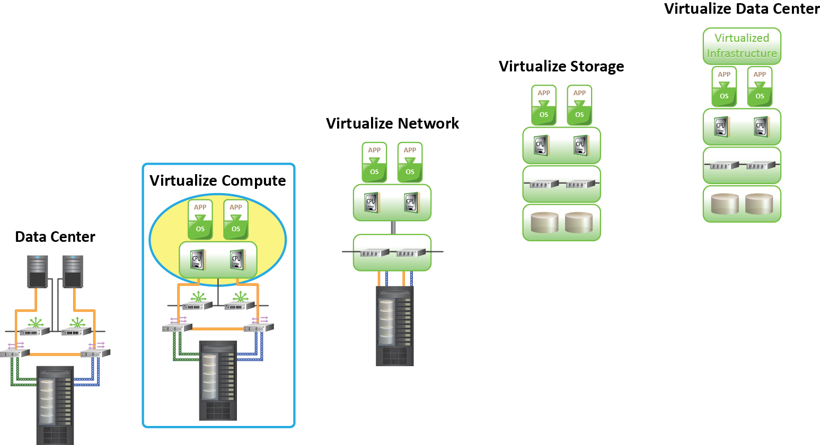
Classic Data Center
Classic Data Center
Core elements of classic data center are:
Compute
Storage
Network
Operating System
DBMS
Application

Slide 35
Virtualized Data Center
Virtualization may be implemented at compute, storage, network, and/or application layers
Virtualization Benefits:
Optimizes utilization of IT infrastructure
Reduces cost and management complexity
Reduces deployment time
Increases flexibility

Slide 36
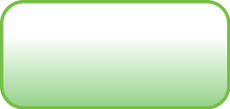
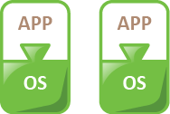


Virtualized Data Center
Classic Data Center
Virtualized Data Center
Virtualized
Infrastructure

Slide 37
Virtualization
Transforms from “one server- one application” to multiple virtual machines on each physical machine
Run Multiple OS on a single machine
A thin layer is introduced over either the hardware or on top of the OS
Leaders in Virtualization – VMware, Citrix Xen

Slide 38
Hypervisor
Hypervisor or Virtual Machine Monitor (VMM) is a software that creates and runs VMs. It can access any of the VM spawned by it. It emulates the physical hardware and prevents direct access to physical hardware.
Multiple instances of a variety of OS’es can share a virtualized resource.

Slide 39
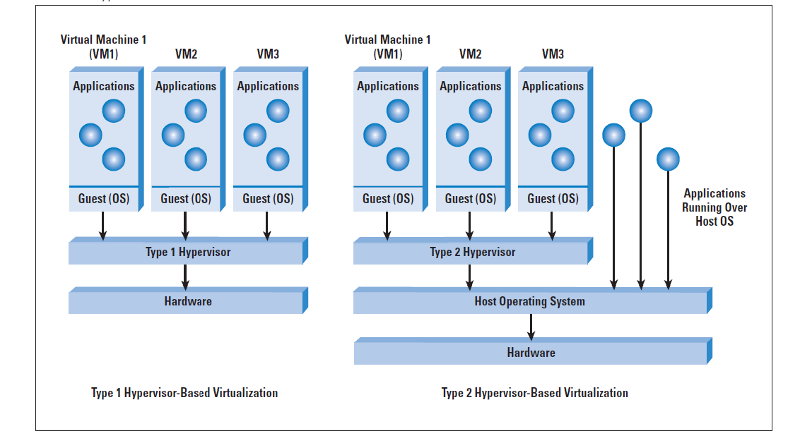
Two types of Hypervisors

Slide 40
Benefits of Hypervisor
Increase server utilization
Consolidate server farms
Decrease complexity
Decrease Total Cost of Ownership (TCO)
Server consolidation refers to the use of a physical server to accommodate one or more server applications or user instances.
Sharing a server’s compute resources among multiple applications and services simultaneously.
It is mainly used to reduce the number of server required in an organization.

Slide 41
Platform as a Service

Slide 42
Platform-as-a-Service
It provides a platform allowing customers to develop, run, and manage applications without the complexity of building and maintaining the infrastructure typically associated with developing and launching an app
Consumer has control over
Deployed applications
Possible application hosting environment configurations
Consumer is billed for platform software components
OS, Database, Middleware ((e.g. Java runtime, .NET runtime, integration, etc.))
Application
Databases
OS
Compute
Storage
Network

Slide 43
PaaS Examples
Google App Engine provides platform for consumers to deploy or create their own applications
Allows dynamic allocation of system resources for an application based on the actual demand
Provides Java and Python environment to create and deploy application
Microsoft Azure Platform provides diverse functionalities to build applications
Uses existing skills with Visual Studio and .Net to build applications
Builds applications also in Java and PHP using Eclipse and other tools
Common Examples: AWS Elastic Beanstalk, Windows Azure, Heroku, Force.com, Google App Engine, Apache Stratos

Slide 44
PaaS
A Platform-as-a-Service (PaaS) cloud provides a toolkit for conveniently developing, deploying, and administering application software that is structured to support large numbers of consumers.

Slide 45
Who are PaaS Customers?
Application developers, who design and implement an application's software.
Application testers, who run applications in various (possibly cloud-based) testing environments.
Application deployers, who publish completed (or updated) applications into the cloud, and manage possible conflicts arising from multiple versions of an application.

Slide 46
Who are PaaS Customers?
Application administrators, who configure, tune, and monitor application performance on a platform.
Application end users, who subscribe to the applications deployed on a PaaS cloud: to end users, access to applications is the same as using a SaaS cloud.

Slide 47
What does the consumer get?
The use of the PaaS cloud provider's tools and execution resources to develop, test, deploy and administer applications.

Slide 48
PaaS: Abstract Interaction Dynamics

Slide 49
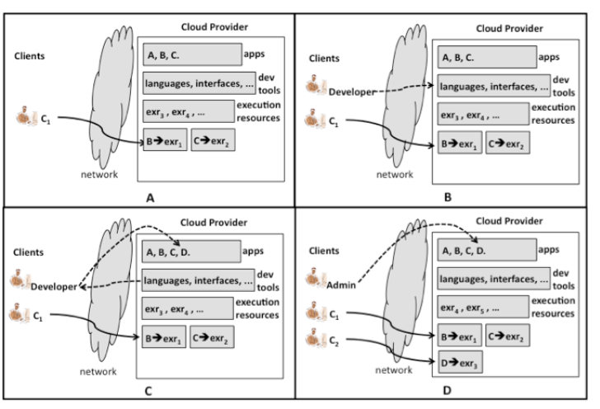
PaaS: Abstract Interaction Dynamics

Slide 50
Explanation
Fig A: B→exr1 and C→exr2 indicating that applications B and C are using separate execution resources
Fig. B: New developer client accesses the development tools of the provider.
*The development tools may include programming languages, compilers, interfaces, testing tools, and mechanisms to deploy an app.
The developer may download tools and use them locally in the developer's infrastructure, or the developer may merely access tools in the provider's infrastructure.

Slide 51
Explanation
Fig. C: In either case, the output of the developer's actions is a new application, D, deployed in cloud.
Fig. D: An administrator is shown configuring the new application that has been made available, and a new client, C2, is shown using the new application.

Slide 52
PaaS: Scope of Control

Slide 53
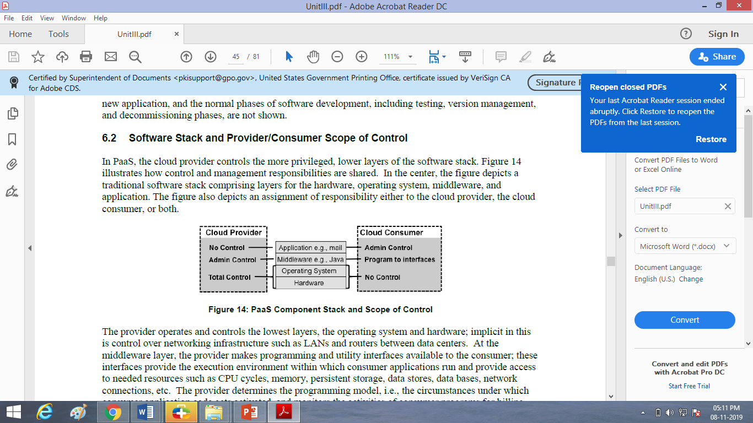
PaaS: Scope of Control

Slide 54
PaaS: Advantages

Slide 55
Platform as a Service (PaaS): Advantages
Reduced Costs
There is no need to:
Purchase hardware and independent tools
Spend working hours on setting up the core stack
Spend working hours on maintaining the stack
Pay unforeseen expenses in case of downtime
Overall leads to cost saving

Slide 56
Platform as a Service (PaaS): Advantages
Improved Time to Market
The increased speed of development and deployment
Developers have access to numerous automated tools and technological innovation.
It also speeds up the process of application development life cycle.

Slide 57
Platform as a Service (PaaS): Advantages
Continuous Updates
PaaS experts constantly perform all the necessary component updates and security patches for you.
Ensures that your application is running on the latest stack, saving your time and resources.

Slide 58
Platform as a Service (PaaS): Advantages
Scalability
The scalability of PaaS is provided by default due to scaling mechanism.
It involves the automatic allocation and release of the necessary resources,

Slide 59
Platform as a Service (PaaS): Advantages
Freedom of Action
Developers, in turn, are free to create their own software and don’t depend on providers to develop a custom solution.

Slide 60
Disadvantages of PaaS

Slide 61
Disadvantages of PaaS
Dependency on Vendor
Our business will still be governed by the provider’s functional capabilities, speed and reliability.
We need to rely on vendor even for reliable functioning of all the tools.

Slide 62
Disadvantages of PaaS
Compatibility of Existing Infrastructure:
A new platform is a new environment where legacy solutions are supposed to continue to work.
it’s crucial to understand possible compatibility problems beforehand.

Slide 63
Disadvantages of PaaS
Security Risks
PaaS software is available in a public environment where multiple end users have access to the same basic resources.
Security is a major concern.

Slide 64
Challenges of PaaS

Slide 65
Challenges of PaaS
Monitoring – not on the platform level, but on the solution level. You still want to ensure that whatever you’re building works fine
Access control – who has access where, how you secure your data and how you integrate with external companies and identity providers… You still need to manage all this, now more than ever, as the capabilities extend far beyond your local Active Directory

Slide 66
Challenges of PaaS
Backup – not all cloud services have built-in backup capabilities. You’ll need to pay some attention to more advanced data storage technologies
Restore – backups are done automatically but restores, of course, are not
Geo-optimization of services – the cloud enables you to provide your online services globally with ease, but doing that efficiently requires proper planning

Slide 67
Popular examples of PaaS include:
AWS Elastic Beanstalk
Windows Azure
Heroku
Force.com
Google App Engine
OpenShift

Slide 68
Software as a Service

Slide 69
Software-as-a-Service
Consumer
Capability provided to the consumer to use provider’s applications running in a Cloud infrastructure
Complete stack including application is provided as a service
Application is accessible from various client devices, for example, via a thin client interface such as a Web browser
Billing is based on the application usage
Application
Databases
OS
Compute
Hired Resources
Storage
Network

Slide 70
SaaS Examples
EMC Mozy is a Software-as-a-Service solution for on-line backup
Consumers can leverage the Mozy console to perform automatic, secured, online backup and recovery of their data with ease
Salesforce.com is a Software-as-a-Service solution for CRM application
Consumers can access CRM applications from anywhere, any time
Common Examples: Google Apps, Microsoft office365, Google docs, Gmail

Slide 71
SaaS: Abstract Interaction Dynamics and Scope of Control
Source: Cloud Computing Synopsis and Recommendations by NIST (Special Publication 800-146)

Slide 72
Software-as-a-Service Environments
A per NIST, SaaS refers to services in which:
“Software deployed as a hosted service and accessed over the Internet.”

Slide 73
Who are the consumers?
Organizations providing their members or employees with access to typical software applications such as office productivity or email.
End users who directly use software applications, whether on their own behalf or that of their organization.
Software application administrators who configure an application for end users.

Slide 74
What does a consumer get?
The right to use specific applications on demand

Slide 75
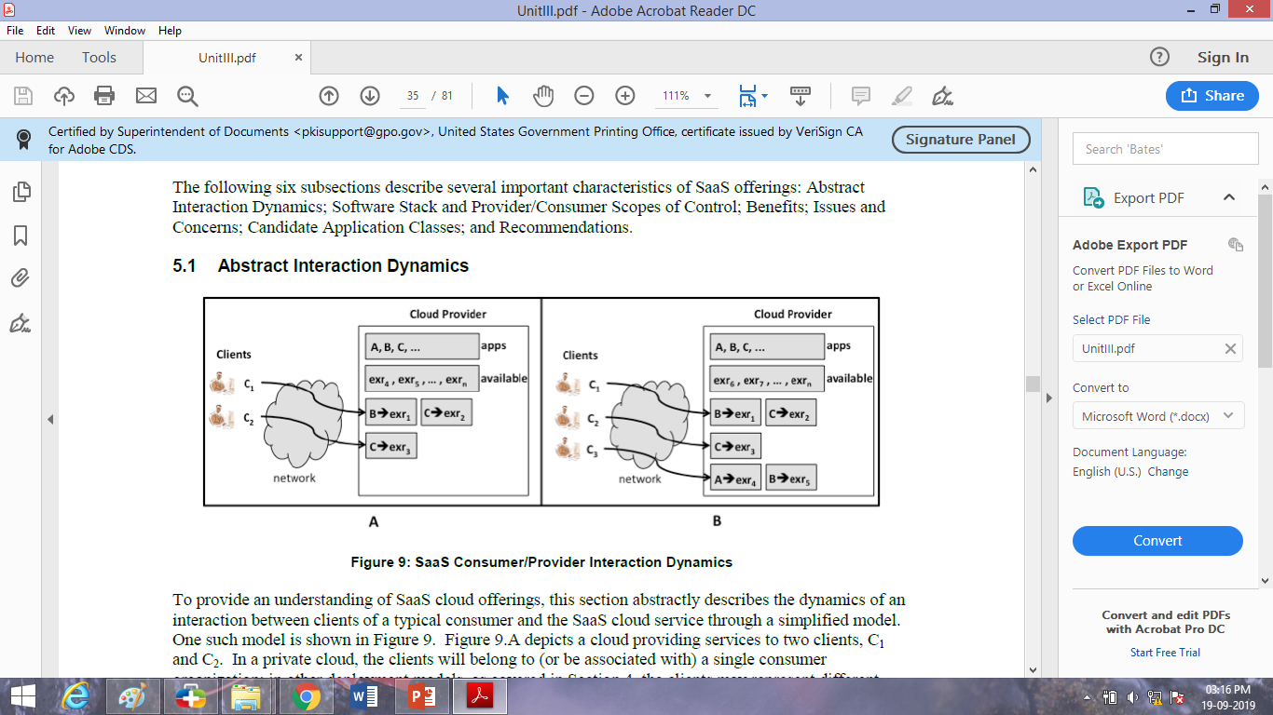
SaaS: Abstract Interaction Dynamics

Slide 76
SaaS: Abstract Interaction Dynamics
Cloud providing services to two clients, C1 and C2
The cloud provider possesses an inventory of software applications ("apps" in the figure) that it is offering to clients for use over the network.
the cloud provider possesses application execution resources (labeled "exr" in the figure)
Client C1 is currently using two applications, B and C
Cloud provider has allocated two execution resources, exr1 and exr2 to Appl. B and C respectively.

Slide 77
SaaS: Abstract Interaction Dynamics
exr1 supplying the processing power and other resources to run the B
exr2 supplying the processing power and other resources to run the C.
An execution resource might be, e.g., a physical computer, a virtual machine, or a running server program .
Client C2, is using one application, C, which is supported by execution resource exr3.

Slide 78
Observations
Same Application can be rented out to different customers.
Additional client requests applications from the cloud, the cloud provider allocates extra execution resources.

Slide 79
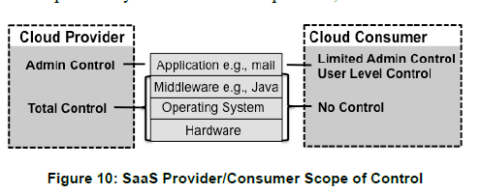
SaaS: Scope of Control

Slide 80
SaaS advantages
SaaS offers many potential advantages over the traditional models of business software installation, including:
Lower up-front cost - SaaS is generally subscription-based and has no up-front licence fees resulting in lower initial costs. The SaaS provider manages the IT infrastructure that is running the software, which brings down fees for hardware and software maintenance.
Quick set up and deployment - SaaS application is already installed and configured in the cloud. This minimises common delays resulting from often lengthy traditional software deployment.

Slide 81
Easy upgrades - The SaaS providers deal with hardware and software updates, deploying upgrades centrally to the hosted applications and removing this workload and responsibility from you.
Accessibility – All you need to access a SaaS application is a browser and an internet connection. This is generally available on a wide range of devices and from anywhere in the world, making SaaS more accessible than the traditional business software installation.
Scalability – SaaS providers generally offer many subscription options and flexibility to change subscriptions as and when needed, eg when your business grows, or more users need to access the service.

Slide 82
Disadvantages of SaaS
Lack of control - In-house software application gives businesses a higher degree of control than hosted solutions where control resides with a third party. Typically everyone has to use the latest version of the software application and cannot defer upgrades or changes in the features.
Security and data concerns - Access management and the privacy of sensitive information is a major consideration around cloud and hosted services.
Identity management
Session management
Access control

Slide 83
Connectivity requirement - Since the SaaS model is based on web delivery, if your internet service fails, you will lose access to your software or data.
Performance - SaaS may run at somewhat slower speeds than on-premise client or server applications, so it's worth keeping performance in mind
your software isn't hosted on a local machine.
Regulations and Compliance
GDPR

Slide 84
Data mobility
Exit strategy?
Limited range of applications - While SaaS is becoming more popular, there are still many applications that don't offer a hosted platform.

Slide 85
Challenges in SaaS Integration
Hybrid IT infrastructure and its challenges: The challenge here is that the IT department has to ensure that they have taken the necessary care to integrate SaaS tools with your existing IT tools.
Access challenges
When integrating SaaS tools, access control becomes a challenge too. The access control and monitoring settings that are applicable in a traditional software are not successfully carried forward to SaaS applications.

Slide 86
Cost of integration
Another major factor for SaaS integration is cost. It is very expensive to integrate SaaS, and your IT team needs to be highly skilled too in order for the integration to be successful. You have to bear the additional cost of highly skilled IT technicians
Time constraints
Most companies opting for SaaS are generally in a hurry to get the application up and running. However, ‘time’ is another major hurdle that companies wanting to switch over to SaaS have to face.

Slide 87
Faulty integration
If the integration is not up to the mark, many problems can arise. You may realize your sales and accounting data is not in sync with your CRM, your users are uploading files and making changes in different systems, invoices are sent to wrong customers, your data is leaked, automatic information gathering is not so automatic, so on and so forth.

Slide 88
Popular examples of SaaS include:
Google Workspace(formerly GSuite)
Dropbox
Salesforce
Cisco WebEx
SAP Concur
GoToMeeting

